Slide 1
Advanced Databases Lecture 9: Graph Databases
Dr. Pierpaolo Dondio,
DT228 - ASD

Slide 2
Graph Databases
Data Model
Nodes with properties
Named relationships with properties
Examples
Neo4j, Sones GraphDB, OrientDB, InfiniteGraph, AllegroGraph
Notes:
Finally we have graph databases. My little section of the NOSQL universe

Slide 3
Graph Databases: Strengths and Weaknesses
Strengths
Extremely powerful data model
Performant when querying interconnected data
Easily to query
Weaknesses
Sharding
Not everything is a graph
Notes:
Has the richest data model of all of the NOSQL types
Graphs are mutable which makes it extremely hard to shard because graphs are naturally mutable. You can shard based on domains but you would need to reduce the chances of creating relationships between the two graphs.

Slide 4
Typical Use Cases for Graph Databases
Recommendations
Business Intelligence
Social Computing
Geospatial
Genealogy
Time Series Data
Web Analytics
Fraud Detection
Notes:
Indexing relational DBs: Some people classify SOLR as a NOSQL store

Slide 5
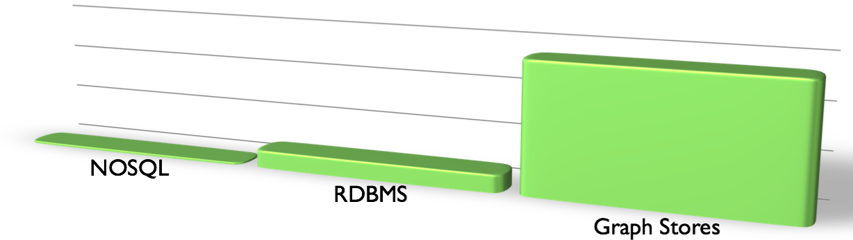
Maturity of Data Models
Most NOSQL: ~8 years
Relational: 42 years
Graph Theory: 276 years
Notes:
The relational model is quite mature, but Graph theory is much older.
So when you boss says that you can’t use Graph database because they’re not mature enough, just tell him that he needs to check his facts.

Slide 6
Data is more connected:
Text
HyperText
RSS
Blogs
Tagging
RDF

Slide 7
Trend 2: Connectedness
GGG
Onotologies
RDFa
Tagging
Wikis
Information connectivity
UGC
Blogs
Feeds
Hypertext
Text Documents
Notes:
UGC = User Generated Content
GGG = Giant Global Graph (what the web will become)

Slide 8
Side note: RDBMS performance
Salary list
Most Web apps
Social Network
Location-based services
Notes:
This is strictly about connected data – joins kill performance there.
No bashing of RDBMS performance for tabular transaction processing
Green line denotes “zone of SQL adequacy”

Slide 9
What is a Graph?

Slide 10

What is a Graph?
An abstract representation of a set of objects where some pairs are connected by links.
Object (Vertex, Node)
Link (Edge, Arc, Relationship)

Slide 11




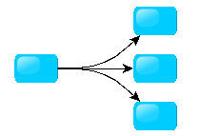
Different Kinds of Graphs
Undirected Graph
Directed Graph
Pseudo Graph
Multi Graph
Hyper Graph
Notes:
An undirected graph is one in which edges have no orientation. The edge (a, b) is identical to the edge (b, a).
A directed graph or digraph is an ordered pair D = (V, A)
A pseudo graph is a graph with loops
A multi graph allows for multiple edges between nodes
A hyper graph allows an edge to join more than two nodes

Slide 12



More Kinds of Graphs
Weighted Graph
Labeled Graph
Property Graph
Notes:
A weighted graph has a number assigned to each edge
A labeled graph has a label assigned to each node or edge
A property graph has keys and values for each node or edge

Slide 13
What is a Graph Database?
A database with an explicit graph structure
Each node knows its adjacent nodes
As the number of nodes increases, the cost of a local step (or hop) remains the same
Plus an Index for lookups

Slide 14
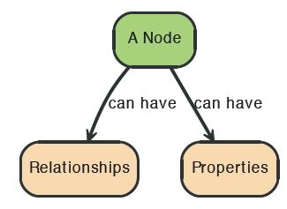

Node in Neo4j

Slide 15
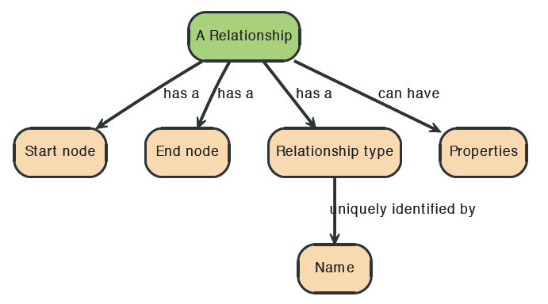
Relationships in Neo4j
Relationships between nodes are a key part of Neo4j.

Slide 16
Properties
Both nodes and relationships can have properties.
Properties are key-value pairs where the key is a string.
Property values can be either a primitive or an
array of one primitive type.
For example String, int and int[] values are valid for properties.

Slide 17
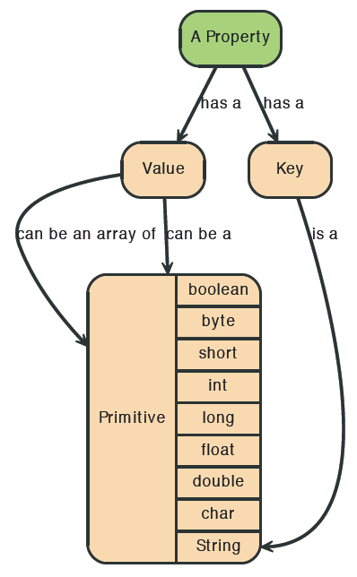
Properties

Slide 18
Graph Data Model
Event
Person
City

Slide 19
Graph Data Model
Event
Rated
Person
Is Attending
Hosted In
Is Located In
City

Slide 20
Graph Data Model
Event
name:DevCon
Rated
score: 11 out of 10
comment: Amazing!!!
Person
firstName:kyle
lastName:adams
Is Attending
Hosted In
Is Located In
City
name:San Jose
country:USA

Slide 21
Neo4j Design Tips: from ER to Graph
Table to Node Label – each entity table in the relational model becomes a label on nodes in the graph model.
Row to Node – each row in a relational entity table becomes a node in the graph.
Column to Node Property – columns (fields) on the relational tables become node properties in the graph.
Business primary keys only – remove technical primary keys, keep business primary keys.
Add Constraints/Indexes – add unique constraints for business primary keys, add indexes for frequent lookup attributes.
Foreign keys to Relationships – replace foreign keys to the other table with relationships, remove them afterwards.
No defaults – remove data with default values, no need to store those.
Clean up data – duplicate data in denormalized tables might have to be pulled out into separate nodes to get a cleaner model.
Index Columns to Array – indexed column names (like email1, email2, email3) might indicate an array property.
Join tables to Relationships – join tables are transformed into relationships, columns on those tables become relationship properties

Slide 22
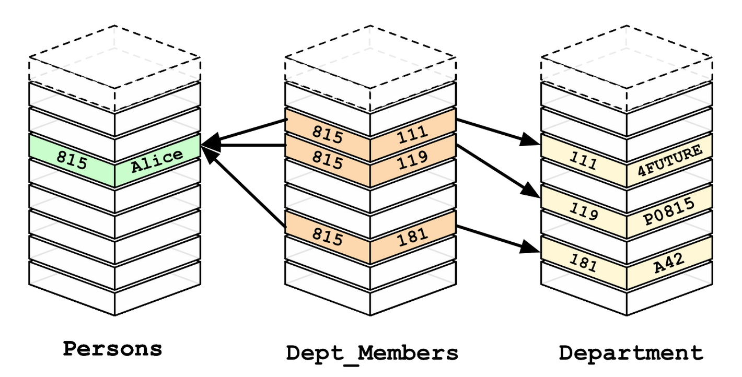
Relational Databases

Slide 23
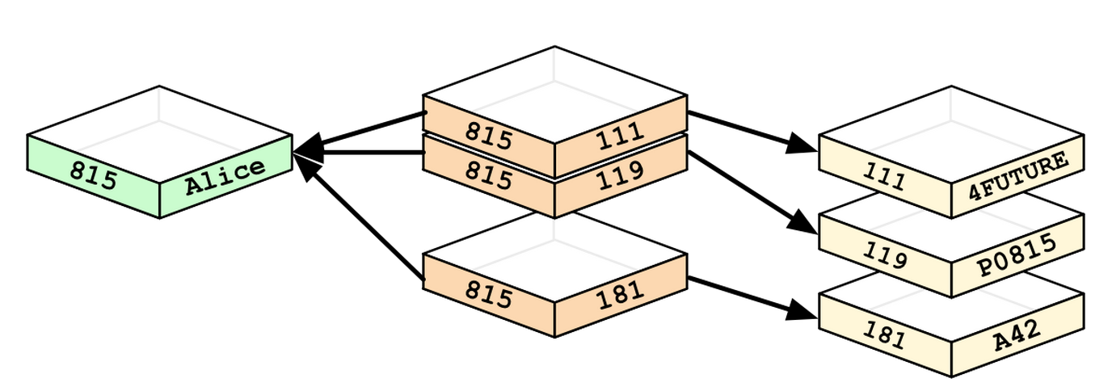
Graph Databases

Slide 24
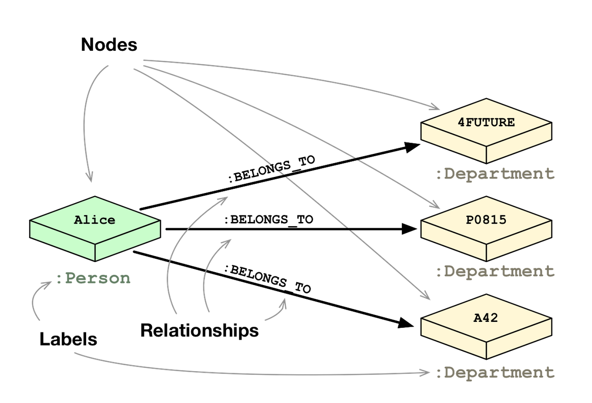
Graph Databases

Slide 25
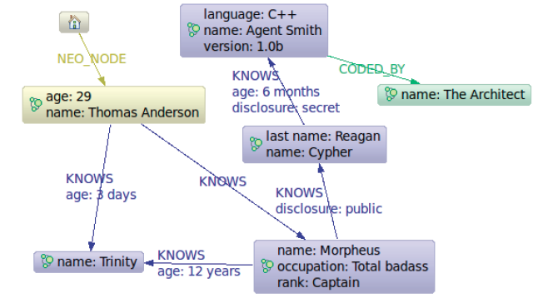
The Matrix Graph Database

Slide 26
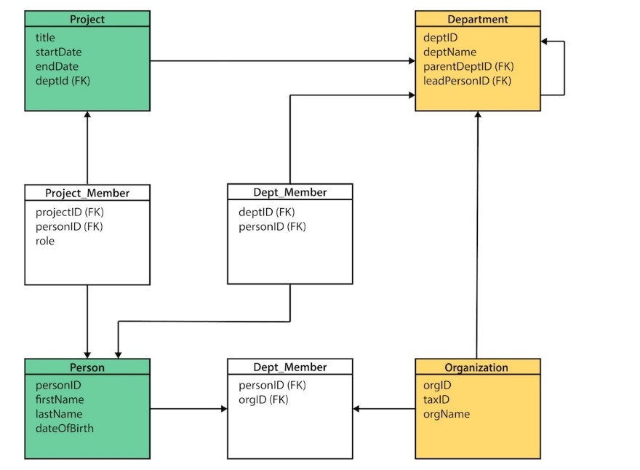
Exercise
Convert the following Relational Model into a Graph DB

Slide 27
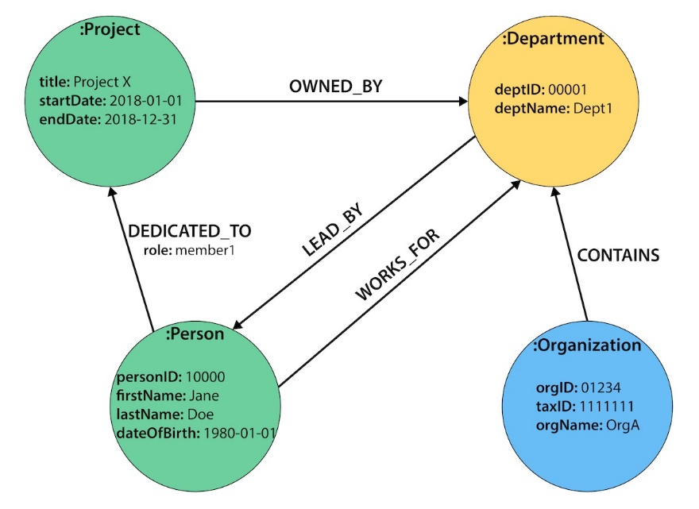
Graph Layout
Good Tutorial:
https://dzone.com/refcardz/from-relational-to-graph-a-developers-guide?chapter=1

Slide 28
Neo4j

Slide 29
Why using Graph Database
SQL
It is hard to represent highly connected data in a graph-like structure.
They are good for “1 step” relations.
NOSQL
Most NOSQL databases store sets of disconnected documents/values/columns.
This makes it difficult to use them for connected data and graphs. One well-known strategy for adding relationships to such stores is to embed an aggregate’s identifier inside the field belonging to another aggregate—effectively introducing foreign keys. But this requires joining aggregates at the application level, which quickly becomes prohibitively expensive

Slide 30


Introducing Neo4j
Introduced in 2010
Developed by Neo Technologies
Most Popular Graph Database
Open source
Java-based
NoSQL Graph Database

Slide 31
Graph Database (cont.)
Nodes represent entities
Edges represent relationships
Connections between data are explored
Faster for associative data sets
Intuitive
Optimal for searching social network data

Slide 32
Graph Databases
Database that uses graph structures with nodes, edges and properties to store data
Provides index-free adjacency
Every node is a pointer to its adjacent element
Edges hold most of the important information and connect
nodes to other nodes
nodes to properties
Notes:
TODO: Add pictures here

Slide 33
Advantage of Graph Databases
When there are relationships that you want to analyze Graph databases become a very nice fit because of the data structure
Graph databases are very fast for associative data sets
Like social networks
Map more directly to object oriented applications
Object classification and Parent->Child relationships

Slide 34
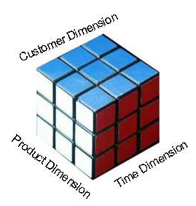
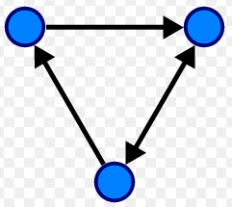
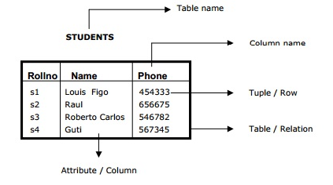
Disadvantages
If data is just tabular with not much relationship between the data, graph databases do not fare well
OLAP support for graph databases is not well developed
Lots of research happening in this area
Ease of aggregation

Slide 35
Major disadvantage
Is it easy to break a graph in pieces?
Partitioning a graph is very hard!
A distribute graph-database is challenging

Slide 36
Salient features of Neo4j
Neo4j is schema free – Data does not have to adhere to any convention
ACID – atomic, consistent, isolated and durable for logical units of work
Easy to get started and use
Well documented and large developer community
Support for wide variety of languages
Java, Python, Perl, Scala, Cypher, etc
(Mistry, Deep, 2013)

Slide 37
More Reasons Why Neo4j is Great
High performance graph operations
Traverse 1,000,000+ relationships/sec on commodity hardware
32 billion nodes & relationships per Neo4j instance
64 billion properties per Neo4j instance
Small footprint
Standalone server is ~65mb

Slide 38

Social Network Performance (traversals)
Why a Graph Database? MySQL vs Neo4j
Notes:
This brings us to an experiment in which Neo Technology has benchmarked performance of MySQL and Neo4j in a social graph

Slide 39
Social Network Performance
The Experiment: Round 1
First rule of fight club:
Run a friends of friends query
Second rule of fight club:
1,000 Users
Third rule of fight club:
Average of 50 friends per user
Fourth rule of fight club:
Limit the depth of 5
Fifth rule of fight club:
Intel i7 commodity laptop w/8GB RAM
Notes:
We want to run a query that find all of the friends of Kyle. then the friends of his friends and so on.

Slide 40
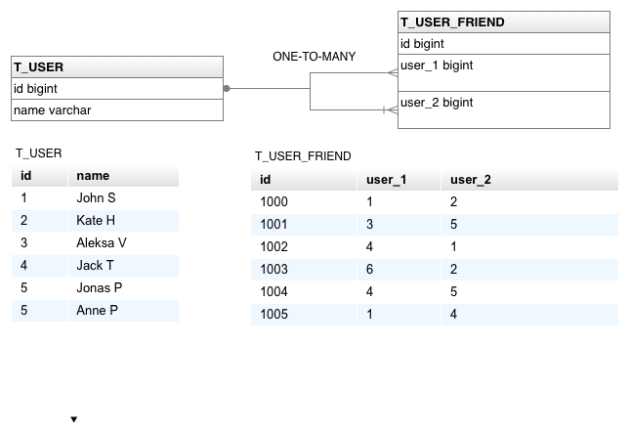
Social Network Performance
RDBMS Schema
Notes:
We have a table that stores all users and another table that stores primary and foreign keys that map the friendships

Slide 41
Social Network Performance
MySQL Results: Round 1- 1,000 Users
Depth | Execution Time (sec) | Records Returned
2 | 0.028 | ~900
3 | 0.213 | ~999
4 | 10.273 | ~999
5 | 92,613.150 | ~999
Notes:
find friends of friends of friends of the user
We see a dramatic decrease in performance the more inner joins we add to the query.

Slide 42
Social Network Performance
SQL: Friends of friends at depth 3
SELECT distinct uf3.*
FROM t_user_friend uf1
INNER JOIN t_user_friend uf2 on uf1.user_1 = uf2.user_2
INNER JOIN t_user_friend uf3 on uf2.user_1 = uf3.user_2
WHERE uf1.user_1 = user_id
Notes:
This is an example of the SQL query used as depth 3. find friends of friends of friends of a particular user

Slide 43
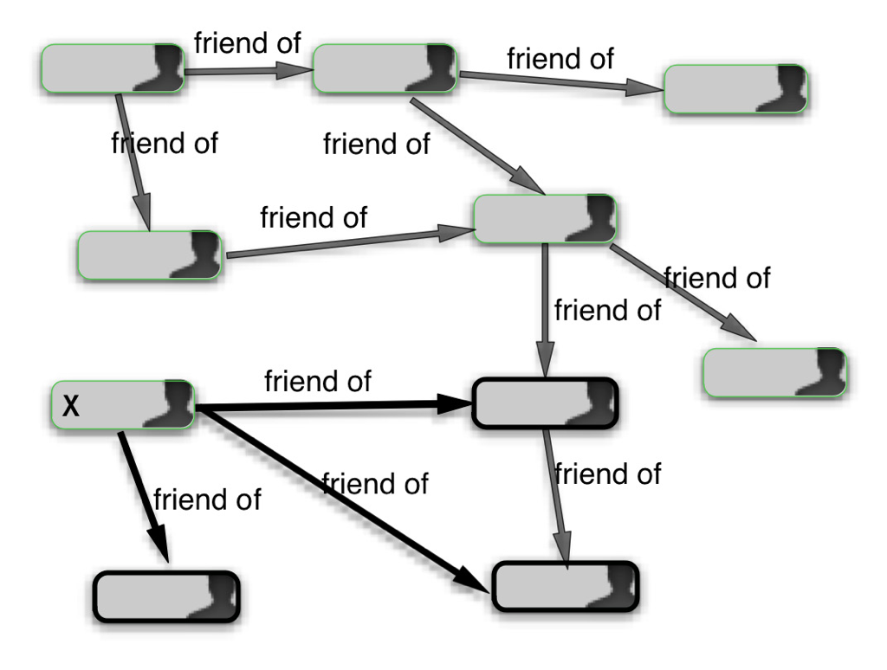
Social Network Performance
Social Graph
Notes:
For Neo4j the social network is a typical graph

Slide 44
Social Network Performance
Neo4j Results: Round 1- 1,000 Users
Depth | Execution Time (sec) | Records Returned
2 | 0.04 | ~900
3 | 0.06 | ~999
4 | 0.07 | ~999
5 | 0.07 | ~999
Notes:
So let look at Neo4j’s performance
We see that performance is relatively unaffected as we increase the depth of traversal

Slide 45
Social Network Performance
The Experiment: Round 2
First rule of fight club:
Run a friends of friends query
Second rule of fight club:
1,000,000 Users
Third rule of fight club:
Average of 50 friends per user
Fourth rule of fight club:
Limit the depth of 5
Fifth rule of fight club:
Intel i7 commodity laptop w/8GB RAM
Notes:
We perform the same queries but we increase the total amount of users to 1 million.
In MySQL we will have 1,000,000 records in t_user table, and approximately 1,000,000 X
50 = 50,000,000 records in t_user_friend table.

Slide 46
Social Network Performance
MySQL Results: Round 1- 1,000,000 Users
Depth | Execution Time (sec) | Records Returned
2 | 0.016 | ~2,500
3 | 30.267 | ~125,000
4 | 1,543.505 | ~600,00
5 | Did not finish after an hour | N/A
Notes:
1,543.505 ~ 25 minutes
Depth five didn’t finish after running for an hour

Slide 47
Social Network Performance
Neo4j Results: Round 1- 1,00,000 Users
Depth | Execution Time (sec) | Records Returned
2 | 0.010 | ~2,500
3 | 0.168 | ~110,000
4 | 1.359 | ~600,000
5 | 2.132 | ~800,000
Notes:
For Neo4j we have a linear increase in execution time.

Slide 48
Social Network Performance
Why is RDBMS performance horrible?
To find all friends on depth 5,MySQL will create Cartesian product on t_user_friend table 5 times
Resulting in 50,000^5 records return
All except 1,000 are discarded
Neo4j will simply traverse through the nodes in the database until there are no more nodes in which to traverse
Notes:
To find all friends on depth 5, MySQL will create Cartesian product on t_user_friend
table 5 times, resulting in 50,0005 records, out of which all but 1,000 are discarded. Neo4j,
on the other hand, will simply visit nodes in the database, and when there is no more nodes
to visit, it will stop the traversal.

Slide 49
Another performance comparison

Slide 50
Conclusion
Key questions to ask yourself
Is my data going to have a lot of relationships?
What sort of questions would I like to ask my database?
Neo4j is a fantastic Graph Database

Slide 51
Cypher
Query Language for Neo4j
Easy to formulate queries based on relationships
Many features stem from improving on pain points with SQL such as join tables
(Hunger, Michael 2013)

Slide 52
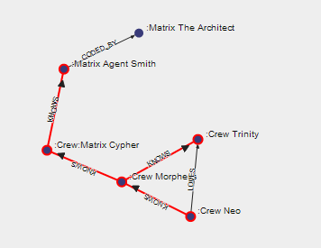
Cypher

Slide 53

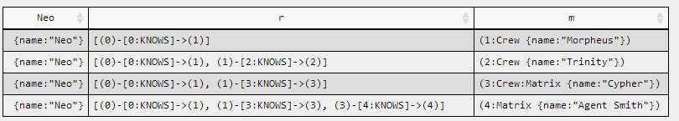
Cypher

Slide 54

Application Domains

Slide 55
Demo
Create nodes with properties
Match nodes
Create relationships between nodes
Traverse the graph
Show paths
Accumulators

Slide 56
Create nodes
Create nodes
CREATE (e1:Student { name: "Emil", from: "Sweden", age: 29 })
CREATE (e2:Student { name: "Paul", from: "Sweden", age: 29, gender: “m” })
CREATE (s1:Subject { name: “Maths", lecturer: “Pierpaolo", age: 29 })

Slide 57
Match Nodes
Match is used to select nodes. A match query must be ended by a Return statement.
MATCH (e:Student) return e;
MATCH (e:Student {age < 25}) return e;
MATCH (e:Student {name: “Emil”});

Slide 58
Create Relationship
Nodes are connected by relationships. Relationship can have nodes as well.
MATCH (e:Student {name:'Emil'}), (r:Student {name:'Joe'}) CREATE (e)-[:FRIEND_OF]->(r)
MATCH (s:Student {name: “Emil”}),(s:Subject {name: “math”})
CREATE (s)-[r:MARK{date:"12/12/2014",mark:55}]->(s) RETURN r

Slide 59
Navigate the graph
Neo4j can easily navigate the graph
MATCH (e:Student {name:"Emil"})-[:FRIEND_OF*1..3]-(e2:Student)
RETURN e2
MATCH (e:Student {name:"Emil"})-[:FRIEND_OF*1..3]-(e2:Student)
RETURN e2.from, COUNT(e2.from) as numfriends
MATCH (e:Student {name:"Alice"})
MATCH path = shortestPath( (e)-[:FRIEND_OF*..5]-(m:Student {name:"Mary"}) )
RETURN path

Slide 60
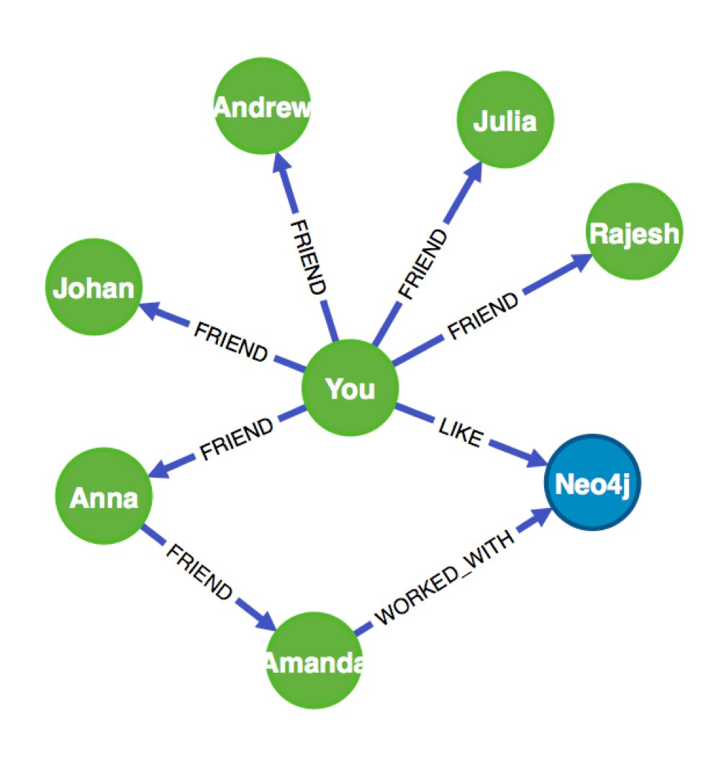
Navigate the graph – mixing properties
MATCH (you {name:"You"})
MATCH (expert)-[:WORKED_WITH]->(db:Database {name:"Neo4j"})
MATCH path = shortestPath( (you)-[:FRIEND*..5]-(expert) )
RETURN db,expert,path

Slide 61
Reduce function
It will go through a list, run an expression on every element, storing the partial result in the accumulator.
Syntax: reduce( accumulator = initial, variable IN list | expression )
Arguments:
accumulator: A variable that will hold the result and the partial results as the list is iterated
initial: An expression that runs once to give a starting value to the accumulator
list: An expression that returns a list
expression: This expression will run once per value in the list, and produces the result value.
MATCH (e:Student {name:"Alice"})
MATCH path = shortestPath( (e)-[:FRIEND_OF*..5]-(m:Student {name:"Mary"}) )
RETURN
reduce(tot = 0, n IN nodes(path) | tot + path.age) as tot_age

Slide 62
Sample code…
CREATE (shakespeare:Author {firstname:'William', lastname:'Shakespeare'}),
(juliusCaesar:Play {title:'Julius Caesar'}),
(shakespeare)-[:WROTE_PLAY {year:1599}]->(juliusCaesar),
(theTempest:Play {title:'The Tempest'}),
(shakespeare)-[:WROTE_PLAY {year:1610}]->(theTempest),
(rsc:Company {name:'RSC'}),
(production1:Production {name:'Julius Caesar'}),
(rsc)-[:PRODUCED]->(production1),
(production1)-[:PRODUCTION_OF]->(juliusCaesar),
(performance1:Performance {date:20120729}),
(performance1)-[:PERFORMANCE_OF]->(production1),
(production2:Production {name:'The Tempest'}),
(rsc)-[:PRODUCED]->(production2),
(production2)-[:PRODUCTION_OF]->(theTempest),
(performance2:Performance {date:20061121}),
(performance2)-[:PERFORMANCE_OF]->(production2),
(performance1)-[:VENUE]->(theatreRoyal),
(performance2)-[:VENUE]->(theatreRoyal),
(newcastle:City {name:'Newcastle'}),
(theatreRoyal)-[:CITY]->(newcastle),

Slide 63
Sample Query
MATCH (theater:Venue {name:'Theatre Royal'}),
(newcastle:City {name:'Newcastle'}),
(bard:Author {lastname:'Shakespeare'}),
(newcastle)<-[:CITY]-(theater)<-[:VENUE]-()-[:PERFORMANCE_OF]->()
-[:PRODUCTION_OF]->(play)<-[:WROTE_PLAY]-(bard)
RETURN DISTINCT play.title AS play
The identifiers newcastle, theater, and bard are anchored to real nodes in the
graph based on the specified label and property values.
The syntax (theater)<-[:VENUE]-() uses the anonymous node, hence the empty
parentheses.

Slide 64
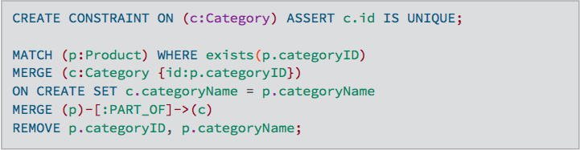
SET A unique KEY
The MERGE clause ensures that a pattern exists in the graph. Either the pattern already exists, or it needs to be created.
Set c.id as unique for all the nodes with label Category.
Create a node category for each product with a category id and link it to the node product and remove the category id and category name from product

Slide 65
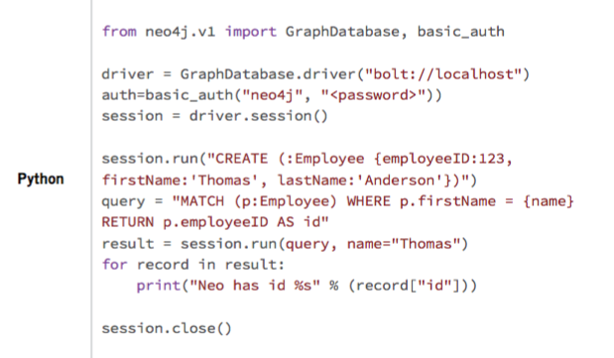
Neo4J From Python

Slide 66


Oracle Striking Back

Slide 67
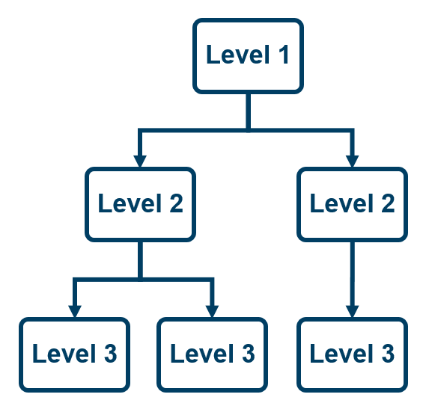
Hierachial and graph-like Query in Oracle
SQL support for hierarchical (=tree-like) or graph-like queries
Dedicated keywords:
Start with
Connect by
See https://docs.oracle.com/cd/B19306_01/server.102/b14200/queries003.htm
It can handle cycles

Slide 68
Hierchical Query
Employees Table
employee_id (PK)
employee_name
employee_lastname
manager_id (FK)
department_id
salary
Recursive relations (table with itself)
How to query that table?
Show all the employee “below” manager 100
Show all the chain from each employee to the CEO
Group the salary of emplyoees by manager

Slide 69
Dataset Used
EMPLOYEE_ID | FIRST_NAME | LAST_NAME | SALARY | MANAGER_ID | DEPARTMENT_ID
103 | Alexander | Hunold | 9000 | 102 | 60
104 | Bruce | Ernst | 6000 | 103 | 60
105 | David | Austin | 4800 | 103 | 60
106 | Valli | Pataballa | 4800 | 103 | 60
107 | Diana | Lorentz | 4200 | 103 | 60
100 | Steven | King | 24000 | - | 90
101 | Neena | Kochhar | 17000 | 100 | 90
102 | Lex | De Haan | 17000 | 100 | 90
108 | Nancy | Greenberg | 12008 | 101 | 100
109 | Daniel | Faviet | 9000 | 108 | 100
110 | John | Chen | 8200 | 108 | 100
111 | Ismael | Sciarra | 7700 | 108 | 100
112 | Jose Manuel | Urman | 7800 | 108 | 100
113 | Luis | Popp | 6900 | 108 | 100

Slide 70
Traverse the tree
In order to traverse a tree from a given node( i.e. return all the nodes below that node) you need to:
Specify the starting node(s) (keyword start with)
Tell how child and parent node are connected (keyword connect_by)
Example:
select * from employees
start with manager_id = 200
connect by prior employee_id = manager_id;
Connect by prior = connect with the parent
Connect by root = connect with the root node

Slide 71
All the nodes above a node?
select employee_id, first_name, last_name, manager_id
from employees
start with employee_id = 107
connect by prior manager_id = employee_id
Note how connect by prior employee_id = manager_id
is different. The field after prior refers to the parent node. If I want to find the boss of a node (=its parent), the employee_id of the parent must be the same as the manager_id of the child, not viceversa!
EMPLOYEE_ID | FIRST_NAME | LAST_NAME | MANAGER_ID
107 | Diana | Lorentz | 103
103 | Alexander | Hunold | 102
102 | Lex | De Haan | 100
100 | Steven | King | -

Slide 72
Level keyword
select level, employee_id, first_name, last_name, manager_id
from employees
start with manager_id is null
connect by prior employee_id = manager_id
LEVEL | EMPLOYEE_ID | FIRST_NAME | LAST_NAME | MANAGER_ID
1 | 100 | Steven | King | -
2 | 101 | Neena | Kochhar | 100
3 | 108 | Nancy | Greenberg | 101
4 | 109 | Daniel | Faviet | 108
4 | 110 | John | Chen | 108
4 | 111 | Ismael | Sciarra | 108

Slide 73
Level keyword – specific level
select level, employee_id, first_name, last_name, manager_id
from employees
where level = 4
start with manager_id is null
connect by prior employee_id = manager_id;
LEVEL | EMPLOYEE_ID | FIRST_NAME | LAST_NAME | MANAGER_ID
4 | 109 | Daniel | Faviet | 108
4 | 110 | John | Chen | 108
4 | 111 | Ismael | Sciarra | 108

Slide 74
Formatting, sorting
Formatting
select level, employee_id, lpad ( ' ', level, ' ' ) || first_name || ' ' || last_name name, manager_id
from employees
start with manager_id is null
connect by prior employee_id = manager_id;
Sort each employee with same manager by first_name
select level, employee_id, first_name, last_name, hire_date, manager_id
from employees
start with manager_id is null
connect by prior employee_id = manager_id
order siblings by first_name;

Slide 75
Avoid LOOPS
update employees
set manager_id = 107
where employee_id = 100;
select * from employees
start with employee_id = 100
connect by nocycle prior employee_id = manager_id

Slide 76
Show Tree Details
update employees
set manager_id = 107
where employee_id = 100;
select employee_id, first_name, last_name, manager_id,
connect_by_root last_name,
sys_connect_by_path ( last_name, ', ') chart,
connect_by_isleaf is_leaf
from employees
start with manager_id is null
connect by prior employee_id = manager_id;
EMPLOYEE_ID | FIRST_NAME | LAST_NAME | MANAGER_ID | CONNECT_BY_ROOTLAST_NAME | CHART | IS_LEAF
109 | Daniel | Faviet | 108 | King | , King, Kochhar, Greenberg, Faviet | 1
110 | John | Chen | 108 | King | , King, Kochhar, Greenberg, Chen | 1

Slide 77
Friends of Friends
The usual friend of friend query with two tables. One with the usernames, the other with the friendship relations
CREATE TABLE graphtable3 ( NODEONE, NODETWO ) AS
SELECT 'A', 'B' FROM DUAL UNION ALL
SELECT 'B', 'C' FROM DUAL UNION ALL
SELECT 'C', 'A' FROM DUAL UNION ALL
SELECT 'D', 'E' FROM DUAL UNION ALL
SELECT 'A', 'E' FROM DUAL UNION ALL
SELECT 'D', 'A' FROM DUAL UNION ALL
SELECT 'G', 'K' FROM DUAL UNION ALL
SELECT 'K', 'L' FROM DUAL UNION ALL
SELECT 'L', 'M' FROM DUAL UNION ALL
SELECT 'Y', 'M' FROM DUAL UNION ALL
SELECT 'G', 'L' FROM DUAL UNION ALL
SELECT 'X', 'Z' FROM DUAL;

Slide 78
Friends of Friends
SELECT
nodeone,
nodetwo,
rowid -- Included as a unique id to differentiate edges with the
-- same start/end points.
FROM graphtable3
START WITH NODEONE = 'A'
CONNECT BY NOCYCLE
PRIOR nodetwo = nodeone
ORDER SIBLINGS BY nodeone, nodetwo

